Slide 1
Machine leaning
Supervised Learning
Introduction
Decision Tree,
Bayesian,
ANN
KNN
Unsupervised Learning (clustering)
Introduction
K-means clustering

Slide 2

An example application
An emergency room in a hospital measures 17 variables (e.g., blood pressure, age, etc) of newly admitted patients.
A decision is needed: whether to put a new patient in an intensive-care unit.
Due to the high cost of ICU, those patients who may survive less than a month are given higher priority.
Problem: to predict high-risk patients and discriminate them from low-risk patients.

Slide 3
Another example (loan application )
A Bank receives thousands of applications for new loans. Each application contains information about an applicant,
age
has a job?
own a house?
credit rating
etc.
Problem: to decide whether an application should approved, or to classify applications into two categories, approved and not approved.

Slide 4



Machine learning and our focus
Like human learning from past experiences.
A computer does not have “experiences”.
A computer system learns from data, which represent some “past experiences” of an application domain.
Our focus: learn a target function that can be used to predict the values of a discrete class attribute, e.g., approve or not-approved, and high-risk or low risk.
The task is commonly called: Supervised learning, classification, or inductive learning.

Slide 5
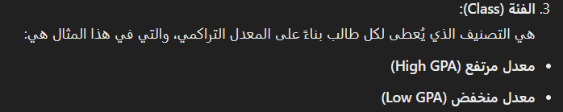

The data and the goal
Data: A set of data records (also called examples, instances or cases) described by
k attributes: A₁, A₂, … A_{k}.
a class: Each example is labelled with a pre-defined class.
Goal: To learn a classification model from the data that can be used to predict the classes of new (future, or test) cases/instances.
Notes:
Induction is different from deduction and DBMS does not not support induction;
The result of induction is higher-level information or knowledge: general statements about data
There are many approaches. Refer to the lecture notes for CS3244 available at the Co-Op.
We focus on three approaches here, other examples:
Other approaches
Instance-based learning
other neural networks
Concept learning (Version space, Focus, Aq11, …)
Genetic algorithms
Reinforcement learning

Slide 6
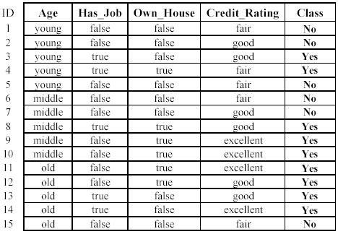

An example: data (loan application)
Approved or not
Attributes or Features

Slide 7
An example: the learning task
Learn a classification model from the data
Use the model to classify future loan applications into
Yes (approved) and
No (not approved)
What is the class for following case/instance?

Slide 8
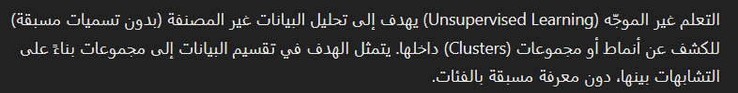
Supervised vs. unsupervised Learning
Supervised learning: classification is seen as supervised learning from examples.
Supervision: The data (observations, measurements, etc.) are labeled with pre-defined classes. It is like that a “teacher” gives the classes (supervision).
Test data are classified into these classes too.
Unsupervised learning (clustering)
Class labels of the data are unknown غير معروفة
Given a set of data, the task is to establish the existence of classes or clusters in the data
المهمة هي تحديد وجود الفئات أو المجموعات في البيانات.
اشراف

Slide 9
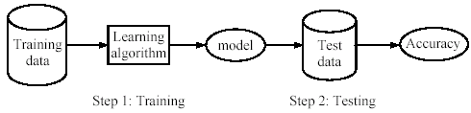
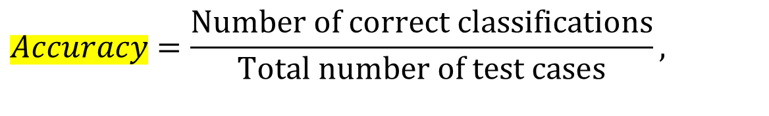



Supervised learning process: two steps
Learning (training): Learn a model using the training data
Testing: Test the model using unseen test data to assess the model accuracy
$$Accuracy=\frac{\text{Number} \text{of} \text{correct} \text{classifications}}{\text{Total} \text{number} \text{of} \text{test} \text{cases}},$$

Slide 10




What do we mean by learning?
Given
a data set D,
a task T, and
a performance measure M,
a computer system is said to learn from D to perform the task T if after learning the system’s performance on T improves as measured by M.
In other words, the learned model helps the system to perform T better as compared to no learning.

Slide 11
An example
Data: Loan application data
Task: Predict whether a loan should be approved or not.
Performance measure: accuracy.
No learning: classify all future applications (test data) to the majority class (i.e., Yes):
Accuracy = 9/15 = 60%.
We can do better than 60% with learning.

Slide 12
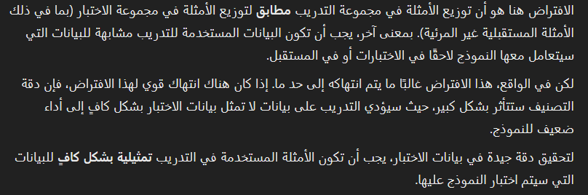


Fundamental assumption of learning
Assumption: The distribution of training examples is identical to the distribution of test examples (including future unseen examples).
In practice, this assumption is often violated to certain degree.
Strong violations will clearly result in poor classification accuracy.
To achieve good accuracy on the test data, training examples must be sufficiently representative of the test data.

Slide 13
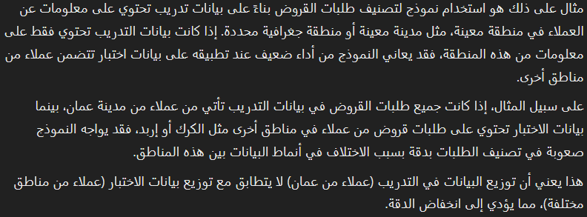
مثال على الافتراض السابق

Slide 14
Decision Tree Learning
Decision tree learning is one of the most widely used techniques for classification.
Its classification accuracy is competitive with other methods, and
it is very efficient.
The classification model is a tree, called decision tree.
C4.5 by Ross Quinlan is perhaps the best known system. It can be downloaded from the Web.

Slide 15
The loan data (reproduced)
Approved or not

Slide 16
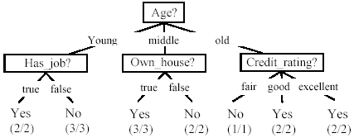
A decision tree from the loan data
Decision nodes and leaf nodes (classes)

Slide 17

Use the decision tree
No

Slide 18
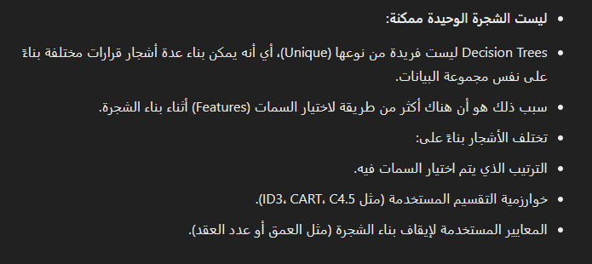
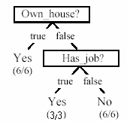
Is the decision tree unique?
No. Here is a simpler tree.
We want smaller tree and accurate tree.
Easy to understand and perform better.
Finding the best tree is NP-hard.
All current tree building algorithms are heuristic algorithms
الخوارزميات الاستدلالية هي تقنيات لا تضمن العثور على الحل الأمثل، لكنها تحاول تقديم حلول جيدة بما يكفي في وقت معقول.
تعتمد على قواعد إرشادية أو تقريبات لتقليل تعقيد الحسابات.

Slide 19
From a decision tree to a set of rules
A decision tree can be converted to a set of rules
Each path from the root to a leaf is a rule.
If any one Own-house➔ loan yes
If any one Own-house and has-job➔ loan yes
If any one not Own-house and not has-job ➔ loan No

Slide 20
Test examples
according to the previous set of rules who Can get a loan?
A young man who has a house and a job but his credit rating fair?
A man who has a house and no job but his credit rating fair?
A woman who has no house and has a job and her credit rating is good?
A man has no house and no job but his credit rating is excellent ?

Slide 21
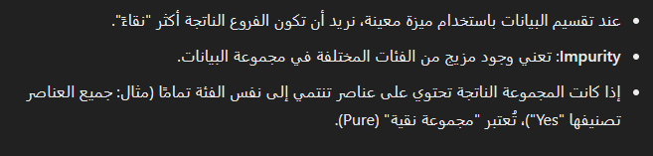
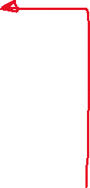

Choose an attribute to partitionلتقسيم data
The key to building a decision tree - which attribute to choose in order to branch.
The objective is to reduce impurity or uncertainty in data as much as possible.
A subset of data is pure if all instances belong to the same class.
The heuristic in C4.5 is to choose the attribute with the maximum Information Gain or Gain Ratio based on information theory (Entropy).

Slide 22
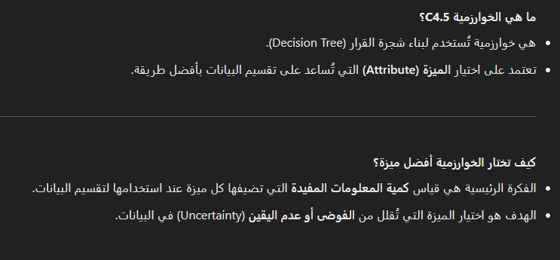
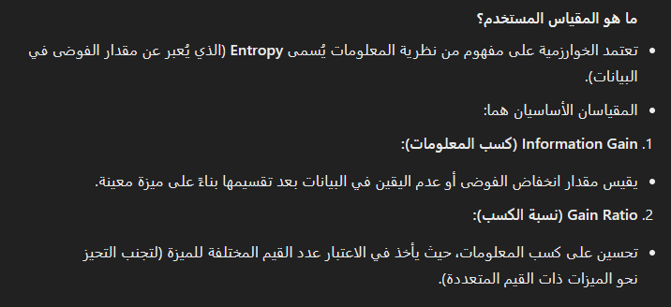
++

Slide 23
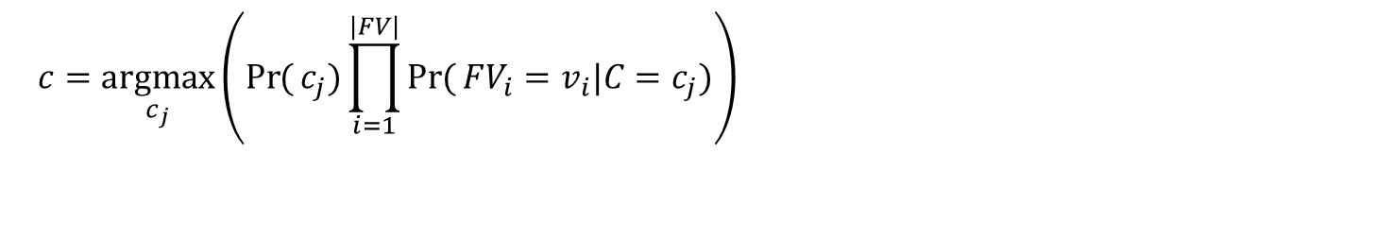
Bayesian classification
Probabilistic view: Supervised learning can naturally be studied from a probabilistic point of view.
Given a test example d with observed attribute values a₁ through |a|, we compute the following to decide the most probable class for the test instance d (depending on the training data).
$$c=\underset{c_{j}}{argmax}\left(\operatorname{Pr}{(}c_{j})\prod_{i=1}^{|FV|}{\operatorname{Pr}{(}FV_{i}=v_{i}|C=c_{j})}\right)$$

Slide 24
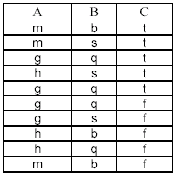
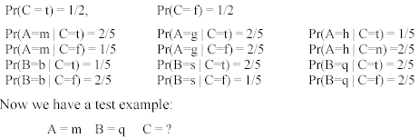


An example
Training step: Compute all probabilities required for classification
Test step

Slide 25
Test example
We have
FV₁=> A FV₂=>B
v₁=m v₂ = q
For C = t, we have

Slide 26
For class C = f, we have
So for A=m, B=q ➔ C = t is more probable.

Slide 27
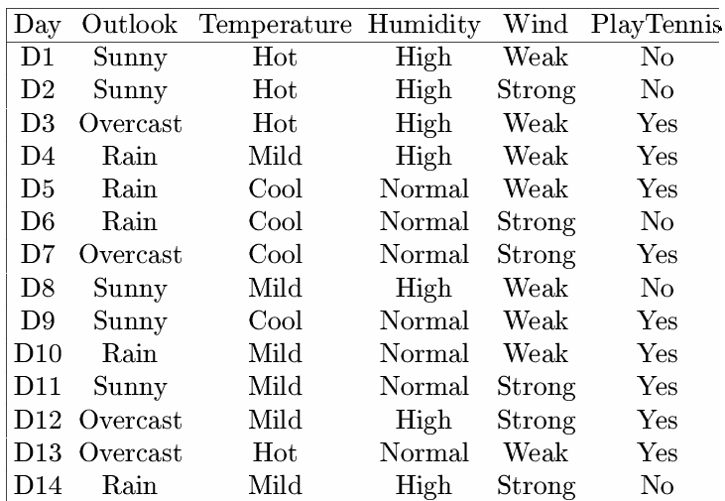





Another example

Slide 28
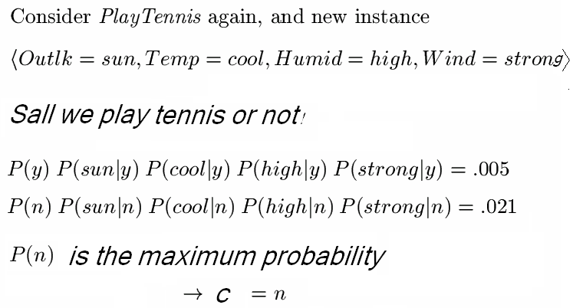
Another example ~ cont.
So according to the Bayesian classification using the provided training data: it is better not to play tennis.

Slide 29
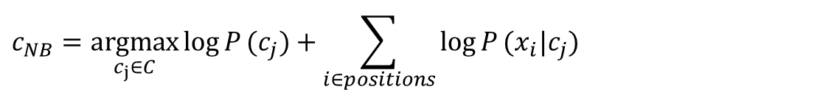
Underflow Prevention
Multiplying lots of probabilities, which are between 0 and 1 by definition, can result in floating-point underflow.
Since log(xy) = log(x) + log(y), it is better to perform all computations by summing logs of probabilities rather than multiplying probabilities.
Class with highest final un-normalized log probability score is still the most probable.
$$c_{NB}=\underset{c_{j}∈C}{\text{argmax}}\log{P}(c_{j})+\sum_{i∈positions}{\log{P}(x_{i}|c_{j})}$$

Slide 30
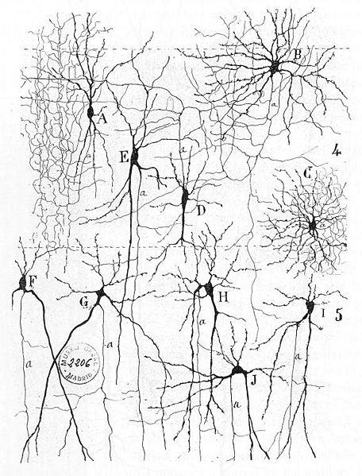
Biological Neural Networks

Slide 31
Artificial Neural Networks (ANN)
Back to biologically inspired approaches..
ANNs are inspired by biological neurons..
Synapse
Axon
Soma
Axon
Dendrites

Slide 32


Biological Neuron
Human brain consists of thousands of millions of neurons.
Each connected to thousands of other neurons.
Neuron receives inputs from its neighbours - may become excited/activated, giving output in turn to other neurons.
Behaviour can change if connections (synapses) between neurons are weakened or strengthened.

Slide 33
Perceptron
The perceptron is a simple computational neuron.
It takes a number of inputs, with weights on the connections (strength of synapse)
if w₁x₁+w₂x₂+w₃x₃+w₄x₄ > threshold then output 1 or true
else output 0 or false
x4
w4
x3
w3
output
inputs
w2
x2
w1
x1

Slide 34
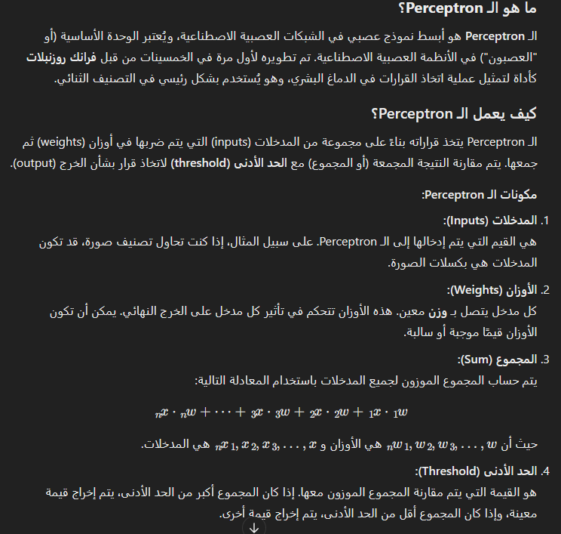
Perceptron By chat GPT

Slide 35
Perceptron ~ example
Example: if All the weights = 0.5
x1 = 1, x2=0, x3=0, x4=0, threshold = 1.
Output = 0
x1=1, x2=1, x3=1, x4=0, threshold = 1.
Output =1
In general, we can have any number of inputs, and different weights on each.
Also may have many interconnected perceptrons.

Slide 36


A sample data set (Tigers)

Slide 37
Learning in ANN
Machine Learning for Neural Nets means adapting the weights, given some examples.
We keep on adjusting the weights a bit, until the neural net gives the output the examples suggest.
Tiger example:
Let each input in the network correspond to one feature (e.g., x1=stripy?). Input has value 1 if feature has value “yes”. And Input has value 0 if feature has value “No”.
We want an output of 1 if it is a tiger, 0 otherwise.

Slide 38
Learning in ANN
Repeat:
For each example
If the predicted value is 1 and class is 0, decrease weights on active connections by small amount.
If the predicted value is 0 and class is 1, increase weights on active connections by small amount.
Until the network gives the right results for all examples.
(Active connections are those for which the input is 1).
The update formula is given as follows
$$W_{new}=W_{old}+lr ∗\left(actual −predicted\right)∗X_{i}$$

Slide 39
Learning tigers
Basic learning rule is:
See what the output is for an example.
If it is wrong, adjust the weights a bit.
Keep going with all the examples, and repeat until weights converge and right results obtained.
E.g., tiger 1, initial weights
1
output
0.5
>1
1
1
0.5
1
0.5
Output 1 and class is 1
Then OK, don’t change
Tiger 2: 0 and 0 ➔ OK

Slide 40
Learning tigers
Tiger 3 -
So increase weights on “active” connections
1
output
0.5
>1
0 but this is not true
1
0.5
0.5
0
1
output
0.6
>1
1
1
0.6
0.5
0

Slide 41
Learning tigers
Tiger 4 and 5 are Ok, Tiger 6 still not quite right.
Decrease weights on active connections.
End up with:
0
output
0.6
>1
1 Wrong
1
0.6
0.5
1
0
output
0.6
>1
1
1
0.5
0.4
1

Slide 42
Test Tigers
Animal A, has big teeth(1), stripy(1) and has a short tail(0)!!!
Is w₁x₁+w₂x₂+w₃x₃+w₄x₄ > threshold (1)
0.6*1+0.5*1+0.4*0=1.1 > 1
A is a tiger
Animal B, has big teeth, not stripy and has a long tail
0.6*1+0.5*0+0.4*1=1, 1 is not > 1
So Animal B is not a tiger

Slide 43
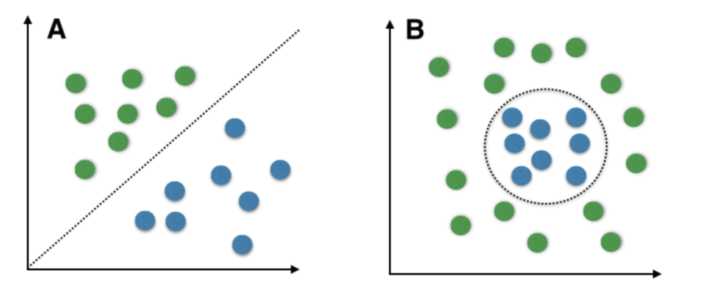
Multi layer perceptron (Traditional ANN)
Problem: perceptron works for linearly separable data (e.g., A)
What is the alternative for non-linearly separable data (e.g., B)?
The solution: Use a network of perceptron (ANN).

Slide 44
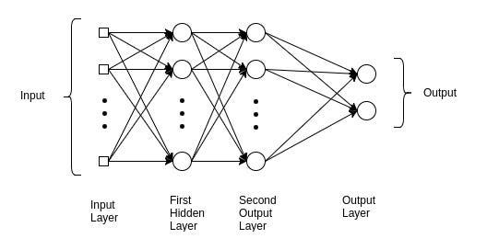
Multi layer perceptron (Diagram)

Slide 45
ANN: Summary
ANNs provide alternative approach to learning, inspired by architecture of brain.
Based on repeatedly modifying weights in simple neurons.
Result is (often) a network that correctly classifies, but which is difficult for human to interpret.
Contrasts with decision trees, which produce human-readable output.
For better learning using ANN, deep learning has emerged.

Slide 46
Deep learning

Slide 47
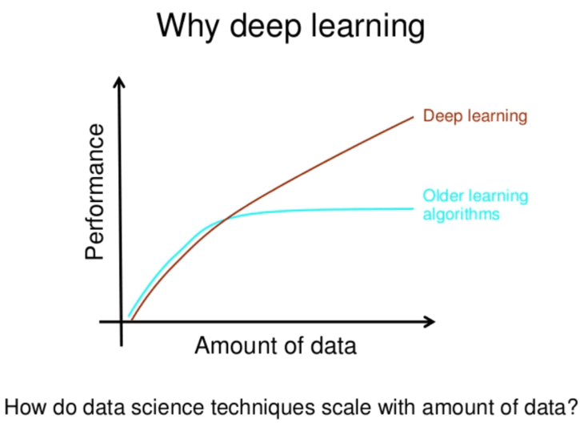
Deep Learning
Traditional ANN has a minor number of parameters, when a small number of hidden layers is used
So we need more parameters to be able to extract sufficient patterns from large datasets

Slide 48
k-Nearest Neighbor Classification (kNN)
Unlike all the previous learning methods, kNN does not build model from the training data.
To classify a test instance d, define k-neighborhood P as k nearest neighbors of d
Count number n of training instances in P that belong to class c_{j}
Estimate Pr(c_{j}|d) as n/k
No training is needed. Classification time is linear in training set size for each test case.

Slide 49
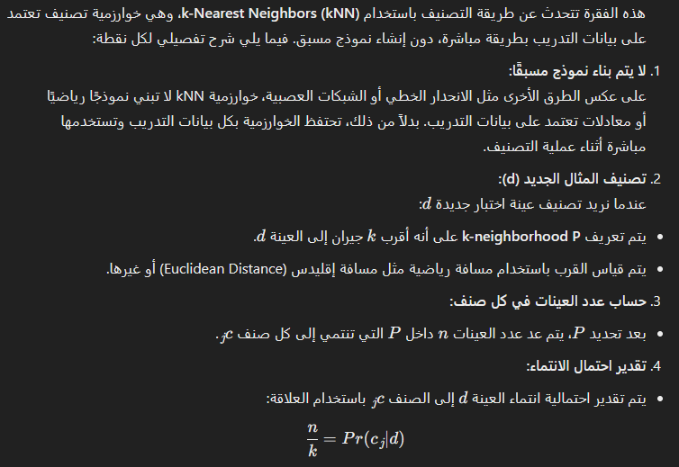

Slide 50


kNN Algorithm
k is usually chosen empirically via a validation set or cross-validation by trying a range of k values.
Distance function is crucial but depends on applications.

Slide 51
Example: k=6 (6NN)
Government
Science
Arts
A new point
Pr(science| )?

Slide 52
Discussions
kNN can deal with complex and arbitrary decision boundaries.
Despite its simplicity, researchers have shown that the classification accuracy of kNN can be quite strong and in many cases as accurate as those elaborate methods.
kNN is slow at the classification time
kNN does not produce an understandable model

Slide 53

Evaluating classification methods
Predictive accuracy
Efficiency
time to construct the model
time to use the model
Robustness: handling noise and missing values
Scalability: efficiency in disk-resident databases
Interpretability:
understandable and insight provided by the model
Compactness of the model: size of the tree, or the number of rules.

Slide 54
Evaluation methods
Holdout set: The available data set D is divided into two disjoint subsets,
the training set D_{train} (for learning a model)
the test set D_{test} (for testing the model)
Important: training set should not be used in testing and the test set should not be used in learning.
Unseen test set provides an unbiased estimate of accuracy.
The test set is also called the holdout set. (the examples in the original data set D are all labeled with classes.)
This method is mainly used when the data set D is large.

Slide 55
Evaluation methods (cont…)
n-fold cross-validation: The available data is partitioned into n equal-size disjoint subsets.
Use each subset as the test set and combine the rest n-1 subsets as the training set to learn a classifier.
The procedure is run n times, which give n accuracies.
The final estimated accuracy of learning is the average of the n accuracies.
10-fold and 5-fold cross-validations are commonly used.
This method is used when the available data is not large.

Slide 56
Evaluation methods (cont…)
Leave-one-out cross-validation: This method is used when the data set is very small.
It is a special case of cross-validation
Each fold of the cross validation has only a single test example and all the rest of the data is used in training.
If the original data has m examples, this is m-fold cross-validation

Slide 57
Summary
Applications of supervised learning are in almost any field or domain.
We studied 4 classification techniques: Decision Tree, Bayesian, ANN and KNN.
There are still many other methods, e.g.,
SVM
HMM
Genetic algorithms
Fuzzy classification and much more
This large number of methods also show the importance of classification and its wide applicability.
It remains to be an active research area.

Slide 58
Unsupervised Learning (clustering)

Slide 59
Supervised learning vs. unsupervised learning
Supervised learning: discover patterns in the data that relate data attributes with a target (class) attribute.
These patterns are then utilized to predict the values of the target attribute in future data instances.
Unsupervised learning: The data have no target (class) attribute.
We want to explore the data to find some intrinsic structures in them.

Slide 60
Clustering
Clustering is a technique for finding similarity groups in data, called clusters. I.e.,
it groups data instances that are similar to (near) each other in one cluster and data instances that are very different (far away) from each other into different clusters.
Clustering is often called an unsupervised learning task as no class values denoting an a priori grouping of the data instances are given, which is the case in supervised learning.
Due to historical reasons, clustering is often considered synonymous with unsupervised learning.
In fact, association rule mining is also unsupervised
This chapter focuses on clustering.

Slide 61
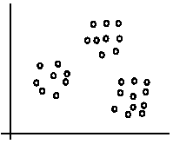
An illustration
The data set has three natural groups of data points, i.e., 3 natural clusters.

Slide 62
What is clustering for?
Let us see some real-life examples
Example 1: groups people of similar sizes together to make “small”, “medium” and “large” T-Shirts.
Tailor-made for each person: too expensive
One-size-fits-all: does not fit all.
Example 2: In marketing, segment customers according to their similarities
To do targeted marketing.

Slide 63
What is clustering for? (cont…)
Example 3: Given a collection of text documents, we want to organize them according to their content similarities,
To produce a topic hierarchy
In fact, clustering is one of the most utilized data mining techniques.
It has a long history, and used in almost every field, e.g., medicine, psychology, botany, sociology, biology, archeology, marketing, insurance, libraries, etc.
In recent years, due to the rapid increase of online documents, text clustering becomes important.

Slide 64
Aspects of clustering
A clustering algorithm
Partitional clustering
Hierarchical clustering
…
A distance (similarity, or dissimilarity) function
Clustering quality
Between-clusters distance ⇒ maximized
Within-clusters distance ⇒ minimized
The quality of a clustering result depends on the algorithm, the distance function, and the application.

Slide 65

K-means clustering
K-means is a partitional clustering algorithm
Let the set of data points (or instances) D be
{x₁, x₂, …, x_{n}},
where x_{i} = (x_{i1}, x_{i2}, …, x_{ir}) is a vector in a real-valued space X ⊆ R^{r}, and r is the number of attributes (dimensions) in the data.
The k-means algorithm partitions the given data into k clusters.
Each cluster has a cluster center, called centroid.
k is specified by the user

Slide 66
K-means algorithm
Given k, the k-means algorithm works as follows:
Randomly choose k data points (seeds) to be the initial centroids, cluster centers
Assign each data point to the closest centroid
Re-compute the centroids using the current cluster memberships.
If a convergence criterion is not met, go to 2).

Slide 67
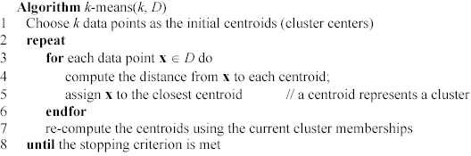
K-means algorithm – (cont …)

Slide 68
Stopping/convergence criterion
no (or minimum) re-assignments of data points to different clusters,
Or no (or minimum) change of centroids
|Previous centriod – current centriod| < threshold

Slide 69
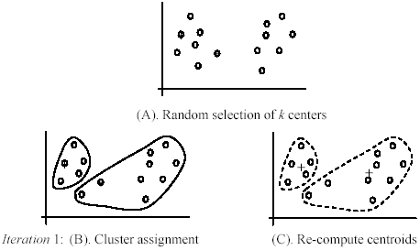
An example
+
+

Slide 70
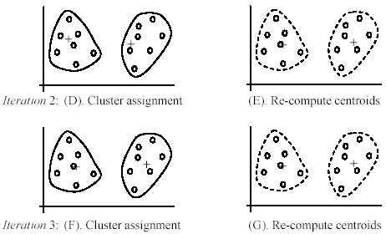
An example (cont …)

Slide 71
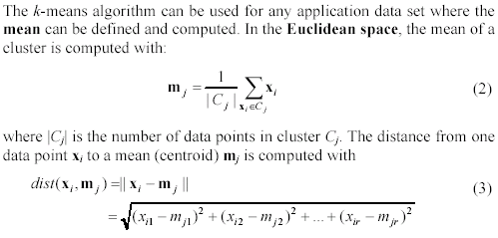
An example distance function

Slide 72
Strengths of k-means
Strengths:
Simple: easy to understand and to implement
Efficient: Time complexity: O(tkn),
where n is the number of data points,
k is the number of clusters, and
t is the number of iterations.
Since both k and t are small. k-means is considered a linear algorithm.
K-means is the most popular clustering algorithm.
Note that: it terminates at a local optimum. The global optimum is hard to find due to complexity.

Slide 73
Weaknesses of k-means
The algorithm is only applicable if the mean is defined.
For categorical data, k-mode - the centroid is represented by most frequent values.
The user needs to specify k.
The algorithm is sensitive to outliers
Outliers are data points that are very far away from other data points.
Outliers could be errors in the data recording or some special data points with very different values.

Slide 74
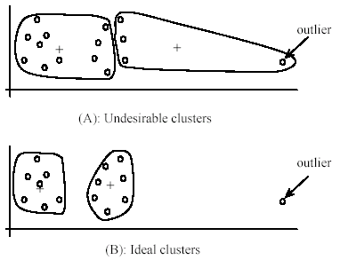
Weaknesses of k-means: Problems with outliers

Slide 75
Weaknesses of k-means: To deal with outliers
One method is to remove some data points in the clustering process that are much further away from the centroids than other data points.
To be safe, we may want to monitor these possible outliers over a few iterations and then decide to remove them.
Another method is to perform random sampling. Since in sampling we only choose a small subset of the data points, the chance of selecting an outlier is very small.
Assign the rest of the data points to the clusters by distance or similarity comparison, or classification

Slide 76
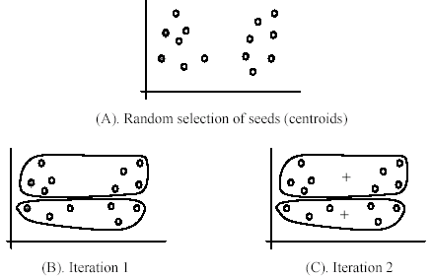
Weaknesses of k-means (cont …)
The algorithm is sensitive to initial seeds.

Slide 77
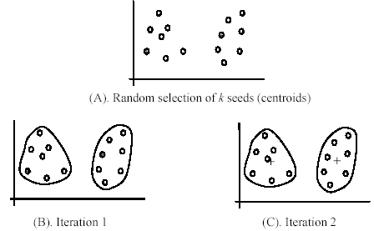
Weaknesses of k-means (cont …)
If we use different seeds: good results
There are some methods to help choose good seeds

Slide 78
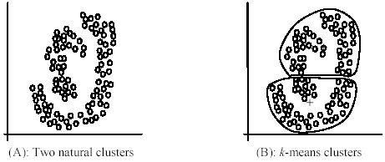
Weaknesses of k-means (cont …)
The k-means algorithm is not suitable for discovering clusters that are not hyper-ellipsoids (or hyper-spheres).
+

Slide 79
K-means summary
Despite weaknesses, k-means is still the most popular algorithm due to its simplicity, efficiency and
other clustering algorithms have their own lists of weaknesses.
No clear evidence that any other clustering algorithm performs better in general
although they may be more suitable for some specific types of data or applications.
Comparing different clustering algorithms is a difficult task. No one knows the correct clusters!

Slide 80
Summary
Clustering is has along history and still active
There are a huge number of clustering algorithms
More are still coming every year.
We only introduced K-means algorithm. There are many others, e.g.,
Hierarchical clustering, density based algorithm, sub-space clustering, scale-up methods, neural networks based methods, fuzzy clustering, co-clustering, etc.
Clustering is hard to evaluate, but very useful in practice. This partially explains why there are still a large number of clustering algorithms being devised every year.
Clustering is highly application dependent and to some extent subjective.

Slide 81
End of AI course I hope you enjoyed it

